Slide 1
Term Project for
CS673 – Software Engineering
Focused Study
(Iteration 0)
Project Presentation by
Siddhesh Dighe
Paridhi Talwar
Deepali Chawla
Pushkar Gharat
Sai Ramya Devineni
Ayush Bhaliya
Supriya

Slide 2
Team Members
Siddhesh Dighe - Team Leader Paridhi Talwar - Requirement Leader
Deepali Chawla- Configuration Leader Pushkar Gharat - Design Implementation Leader
Sai Ramya Devineni - QA Leader
Supriya - Backup QA Leader
Ayush Bhaliya - Security Leader

Slide 3







Motivation
Apps are designed with the goal of keeping us hooked to our phones
They keep us hooked by providing quick, flashy content which doesn’t require a lot of focus
Making us addicted to Passive / Doom Scrolling

Slide 4
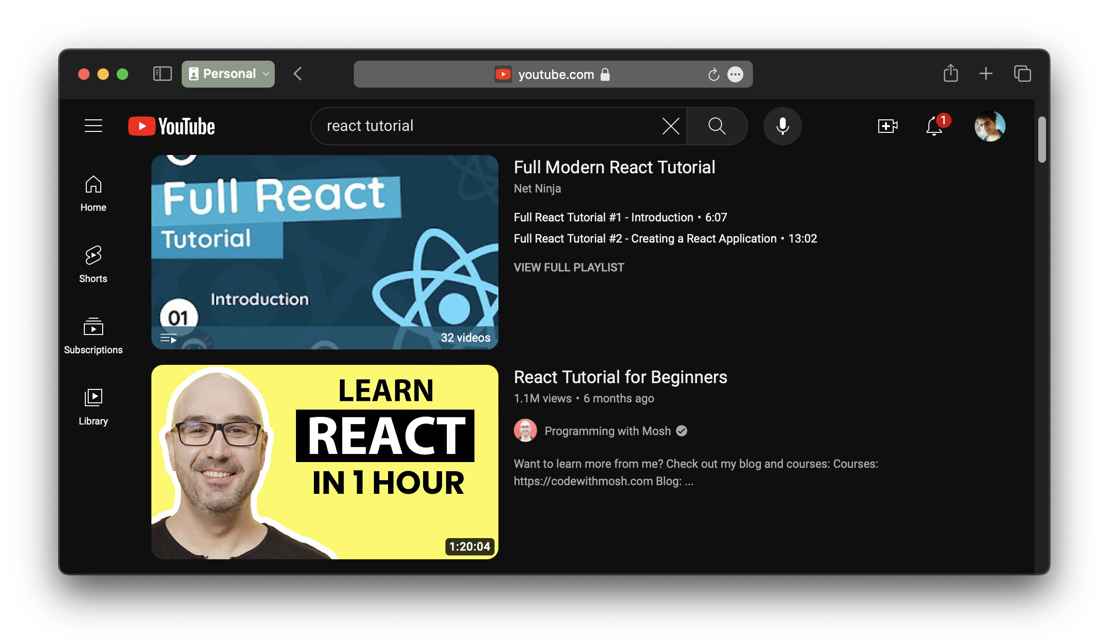
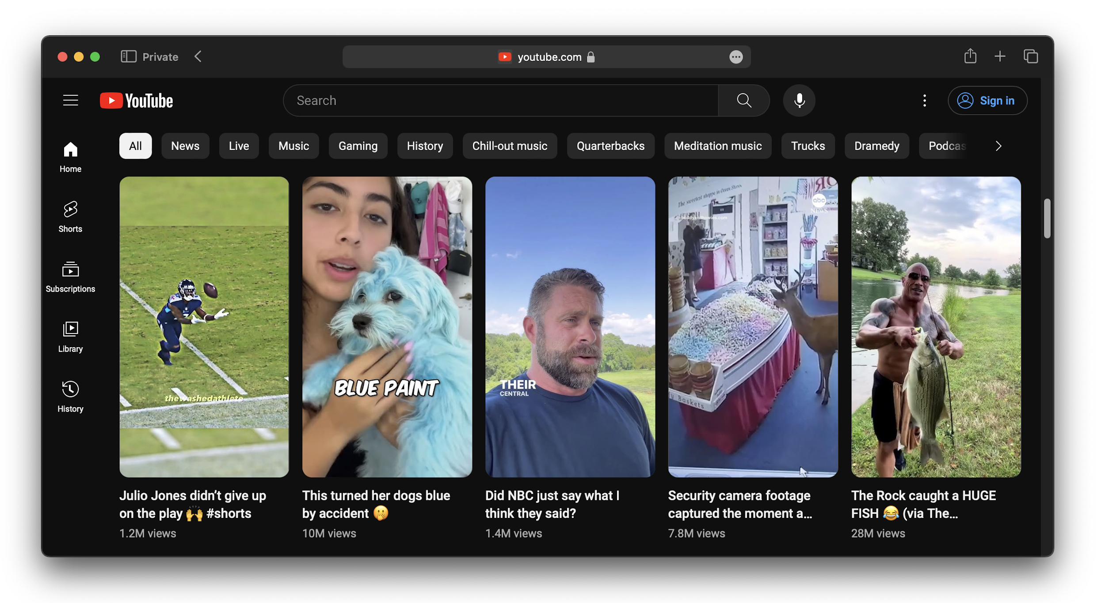
Motivation
Video platforms like YouTube provides a lot of educational content for free but it also has many distractions that can divert your focus from learning
YouTube has a recommendations section which at times can be very distracting with clickbait videos
YouTube also introduced Shorts which enables Passive / Doom Scrolling

Slide 5
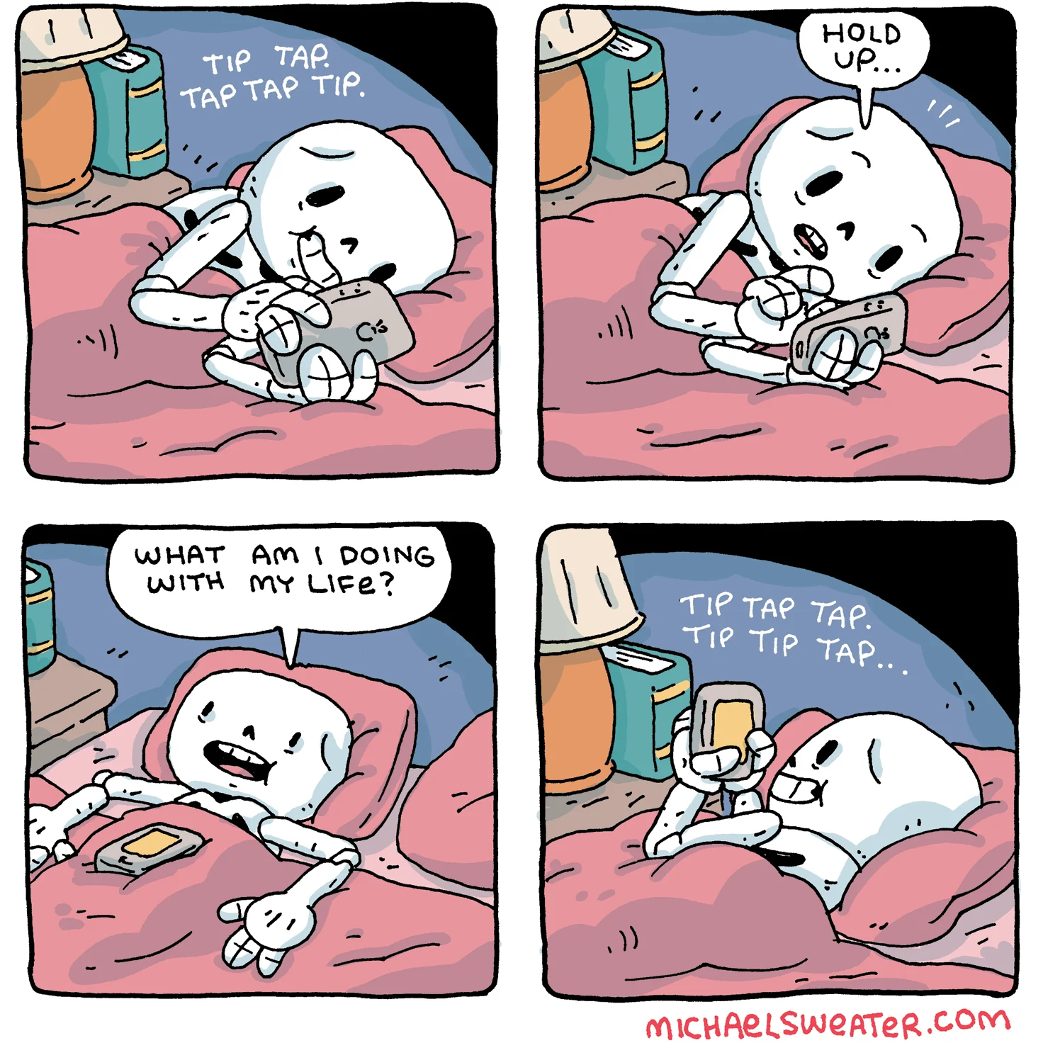
Motivation
Consequences of Passive Scrolling?
Makes it difficult to concentrate on one thing that takes more than a few minutes
Slowly degrades your attention span making it shorter
Hampers your ability of deep thinking to solve complex problems

Slide 6
What is Focused Study?
It’s a web app that aims to solve the issue of distractions and declining attention spans when it comes to learning
Distraction-Free Learning
Gamification
Analytics Dashboard
User’s can search for educational videos using a single search bar on Home page
Rewarding users points for staying focused on learning
Providing insights on users attention span and learning habits
Each video is selected based on multiple factors like best comments, likes-dislike ratio, views
These points can be used to watch more entertainment-focused videos aligned to users hobbies & interests.

Slide 7
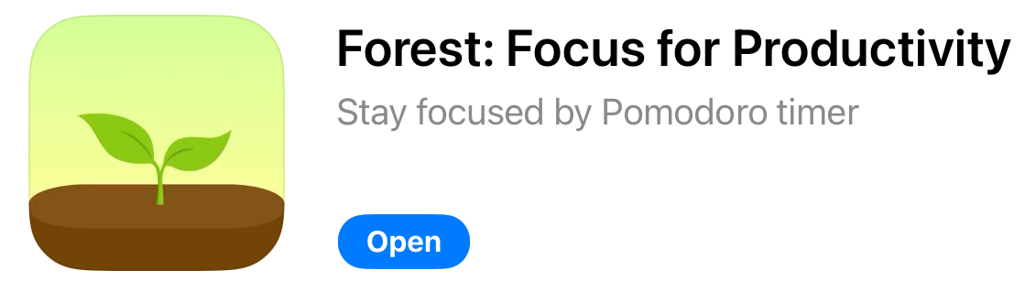
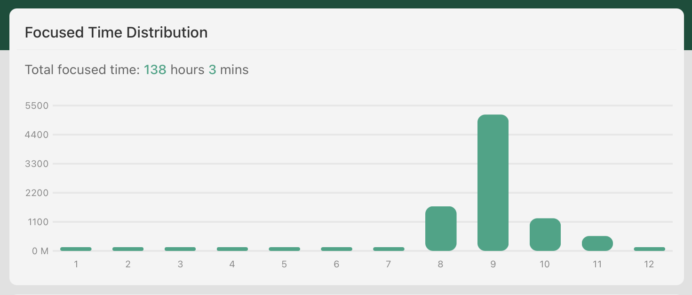
Related Work
Forrest App
Timer app that helps you stay focused on the task at hand using pomodoro technique.
Limitations
Only available on iOS
Only focused on tracking and analytics – doesn’t provide learning content
How is Focused Study different from Forrest app?
Provides content required to learn new things
Accessible from any device with a web browser

Slide 8
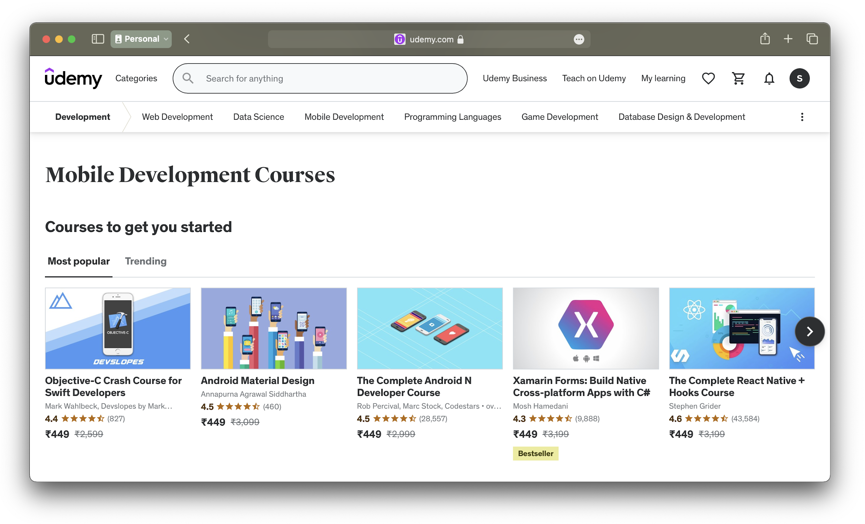
Related Work
Educational Video Platforms (Udemy, Udacity, etc)
Distraction-free video platforms focused only on learning content through courses
Limitations
Courses are paid
They lack in providing analytics and tracking to help user visualize their attention span and learning habits
How is Focused Study different from Educational video platforms?
Free educational videos from YouTube
Provides analytics and tracking tools to visualize users attention span and learning habits

Slide 9
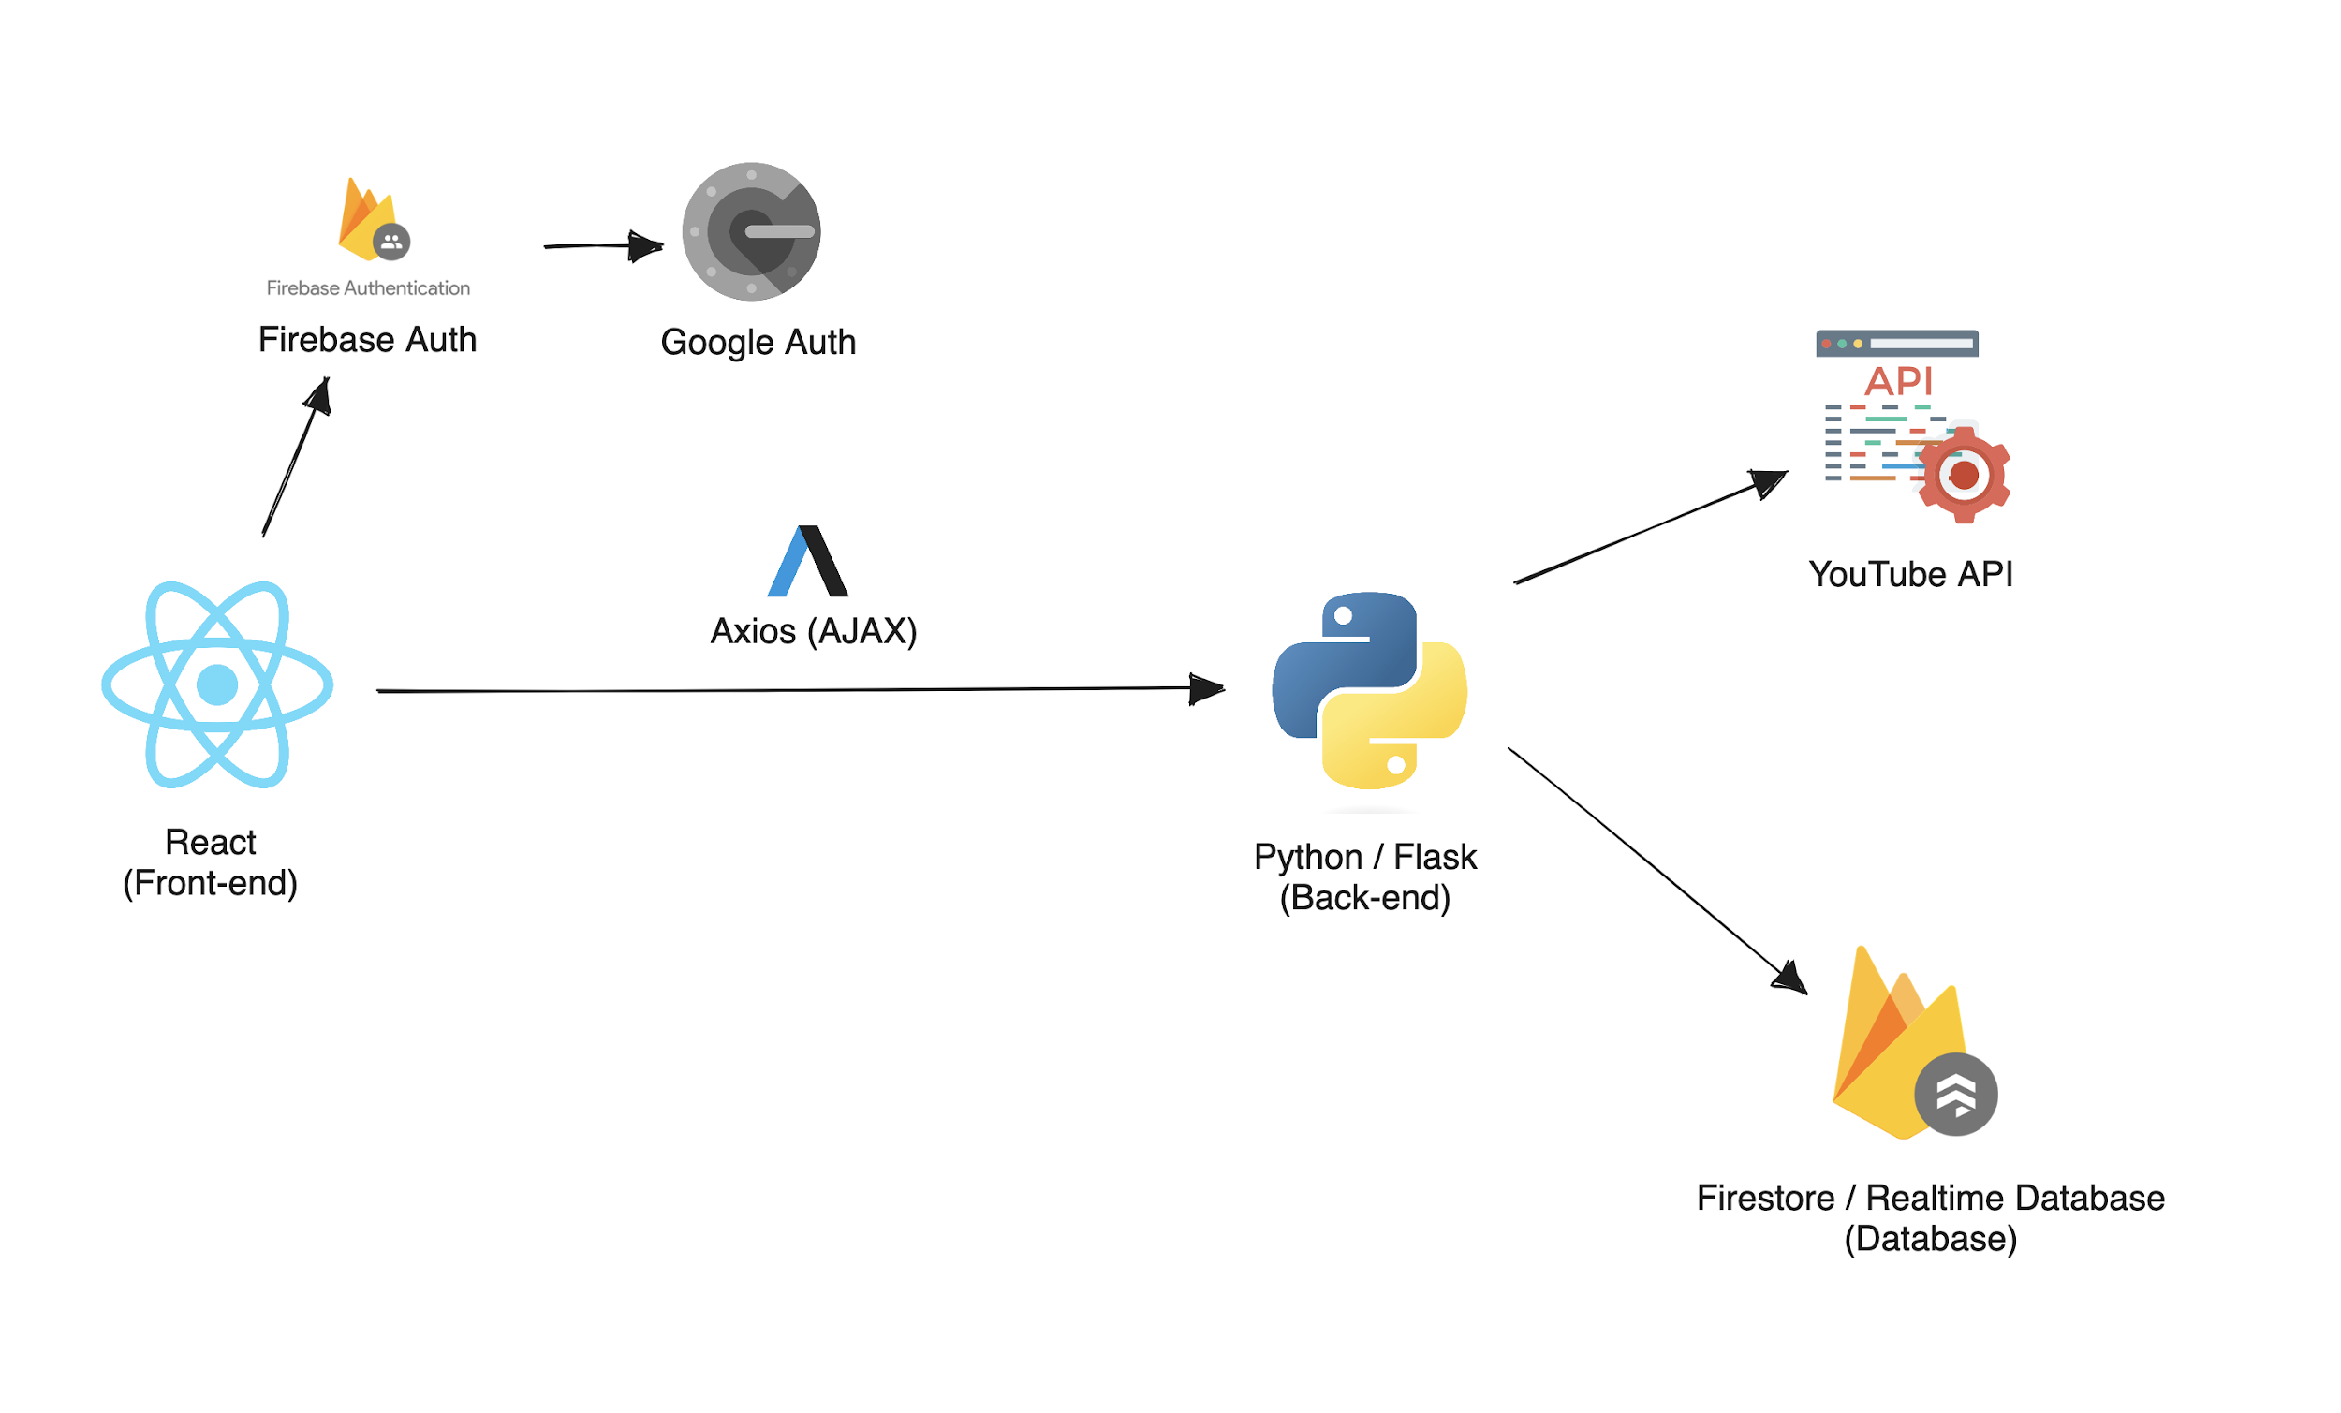
Tech Stack

Slide 10


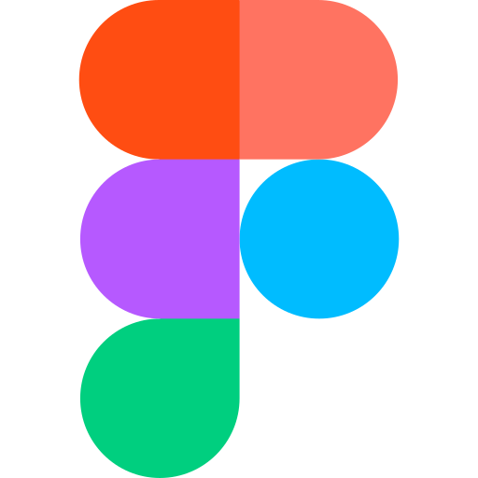

Tools
JIRA
VSCode
We plan to use JIRA for planning sprints and distributing tasks among team members and tracking issues/bugs
We plan to use VSCode as the IDE for development since it provides extensions and plugins for both Python and React frameworks.
Figma
Docker
We plan to use Figma as our primary tool to design wireframes and mockups
We plan to containerize our application using docker

Slide 11






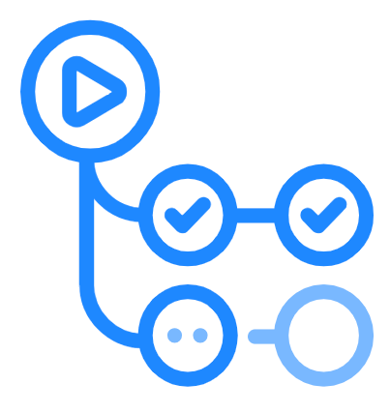
Tools
Git
Git would be our version control tool for maintaining the project.
GitHub Actions
RedHat’s OpenShift Tool
APISec Tool
Would be used for deployment
Would be used to allow continuous testing of API Security
CodeQL
SAST tool to help discover vulnerabilities across codebase
SonarQube
DAST tool
Pysa
GitHub Action Tester
Static analysis tool for Python code
Would be used for automating the testing process

Slide 12
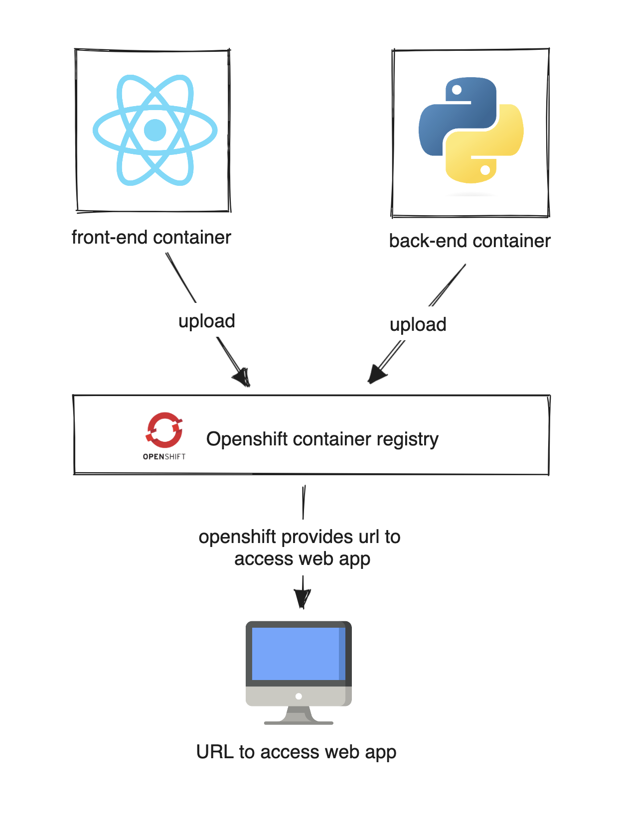
Deployment Plan

Slide 13
Git Branching Strategy
STEP 1 Every feature/JIRA ticket will have a separate branch.
STEP 2 For every piece of code that we commit, we will prefix the commit message with a JIRA Ticket ID
STEP 3 Once all the changes for a particular branch are complete, we will create a pull request from that branch to the main branch
STEP 4 From the main branch, we use tags to maintain our releases

Slide 14
Testing
Manual
Automated
Unit Tests Each member is responsible for adding unit tests for the features.
GitHub Action Tester We’ll be using this tool for automatically running the test cases for each new pull request
UI Tests We would use Cypress for testing applications user interface.
Integration Tests QA Leader would be responsible for adding integration tests.

Slide 15
Thank You

